Slide 1
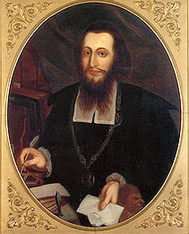
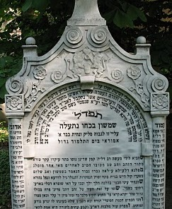
Is a Rabbi Hiding in Your Family Tree?
Lessons from Genetic Genealogy
for Traditional Genealogists
Presented by:
Janet Billstein Akaha
Rachel Unkefer
http://www.jewsoffrankfurt.com
Notes:
HOW MANY PEOPLE HAVE SOME KNOWLEDGE OF DNA FOR GENEALOGY? For our presentation, some knowledge of some basic DNA terms would be helpful, but not necessary.
Unfortunately the handout on the website separated page 1 from pages 2-4. We had difficulty finding it. You will be able to find our presentation on the Jews of Frankfurt website.
Please keep in mind that Rachel and I are not rabbinical scholars, and will not be open to debating the veracity of the lineages in this presentation. Our focus is on the DNA. I started DNA testing my family members about 6 years ago, and Rachel began a few years earlier. From the start both of us started to see though our DNA findings that perhaps we had unknown Rabbis in our family tree. Rachel and I are still both in search of these distant rabbis in our own family tree. My brother’s initial DNA findings led me to search for an offspring of the Weil der Stadt (14th C), and I was also curious about my WERTHEIM line. At the same time Rachel was discovering that her husband’s Bacharch line might actually bear the genetic Y-DNA signature of another famous rabbinical line.
Several years ago both Rachel and I started a DNA Project called the Jews of Frankfurt because we hoped to identify the Y-DNA “signatures” of well-documented surname lines, many of which are rabbinic. We’ve focused on surnames that extend back farther in history than the typical eighteenth or nineteenth century surname adoptions by Jews in Europe. We’ll talk about how you might be able to ride the coattails of someone else’s long pedigree using DNA. In our Jews of Frankfurt DNA project we’ve helped lots of people do just that.

Slide 2
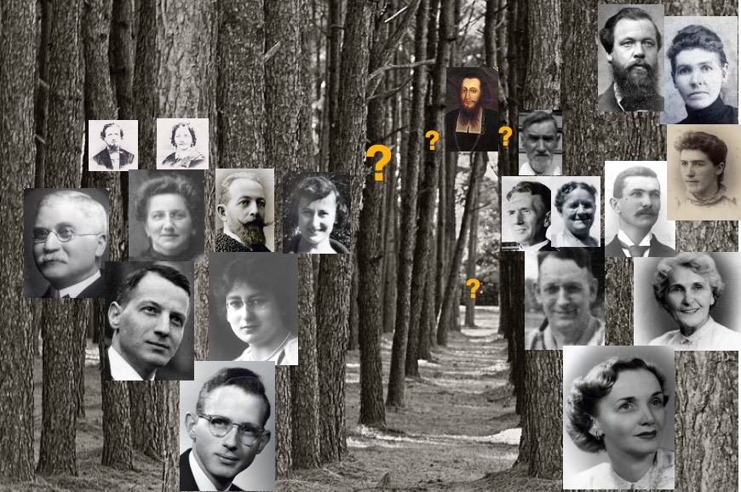
As genealogists we’ve been trained to document every tree in the forest.
The genetic genealogist can identify a distant relative way across the forest.
Notes:
The expression “can’t see the forest for the trees” very aptly illustrates the difference between traditional genealogy and genetic genealogy.
Here is my forest. Like you, I have unearthed all of the vital records, family trees, and oral histories I can find. I have sent out letters to unknown people with similar surnames in hopes of connecting with a distant cousin. Still, I can only trace my family back to around 1700 on my paternal side and a bit further on my maternal side. But whether you can go back to the 19th C, 18th C or even 17th C, we all eventually reach a brick wall and need help breaking through to new unknown relatives who lies in the deep forest of our family pedigree.
Some of you may recognize the picture of the famous R. Samson Wertheimer at the other side of this forest. He is a symbol only of a possible relative that I hope to find. He was born around 1658 in Worms. So, IF he is my ancestor, he would be 10 generations from me. In 10 generations each of us has 1024 direct line ancestors. So he would be only one of the many trees deep in my forest!

Slide 3
THE “BOTTLENECK” (really more like an hourglass)
Historical events (wars, pogroms, pandemics) can drastically reduce a population, after which it expands again from a small number of survivors.
Black Plague ca 1349
(About 21 Generations ago)
Hypothetical 2,073,344 ancestors, but estimates of Ashkenazi Population with modern descendants: 330-350
5 Jul 1349: 41 murdered in Frankfurt, the rest fled.
Source; Kevin McDonald, Occidental Observer, Sept 2014 Exponential Growth of Ashkenazi Jews Following a Medieval Population Bottleneck.
Notes:
3. BOTTLENECK: 1: 40
At ≈ 21 Generations we have over 2 million DIRECT ancestors. 21 generations would take us back to ≈ 1349, the time of the Black Plague when the Jewish population was decimated. Recent studies of Ashkenazi DNA reveals that at this time the Ashkenazi population may have dwindled to around 350 founding fathers. Whether or not this is accurate, the Ashkenazi population was very small.
In Frankfurt, for example the Ele Toldot records which go back to before the Black Plague has death records for 41 individuals were murdered on July 5th, 1349. Who survived? The wealthiest and most connected individuals had the greatest opportunity to flee. Counting up all the ancestor we SHOULD have in 21 generations, it is over 2 million. However, that really isn’t the case. Because of the bottleneck we have over 2 million spots filled with names on our pedigree chart and many of those spots bear the same name multiple times.
Because so few survived, this suggests that the probability of having a distinguished rabbi in your ancestry is almost certain. In fact, when I have made pedigree charts for many of the members of my Jews of Frankfurt project, MOST are related to Rashi multiple times. So If I actually could make a COMPLETE pedigree chart for them, he is probably a direct line ancestor hundreds of times!
Rachel will tell you much more about our project and about how she stumbled upon one rabbinic family that lived prior to the Black Plague.

Slide 4
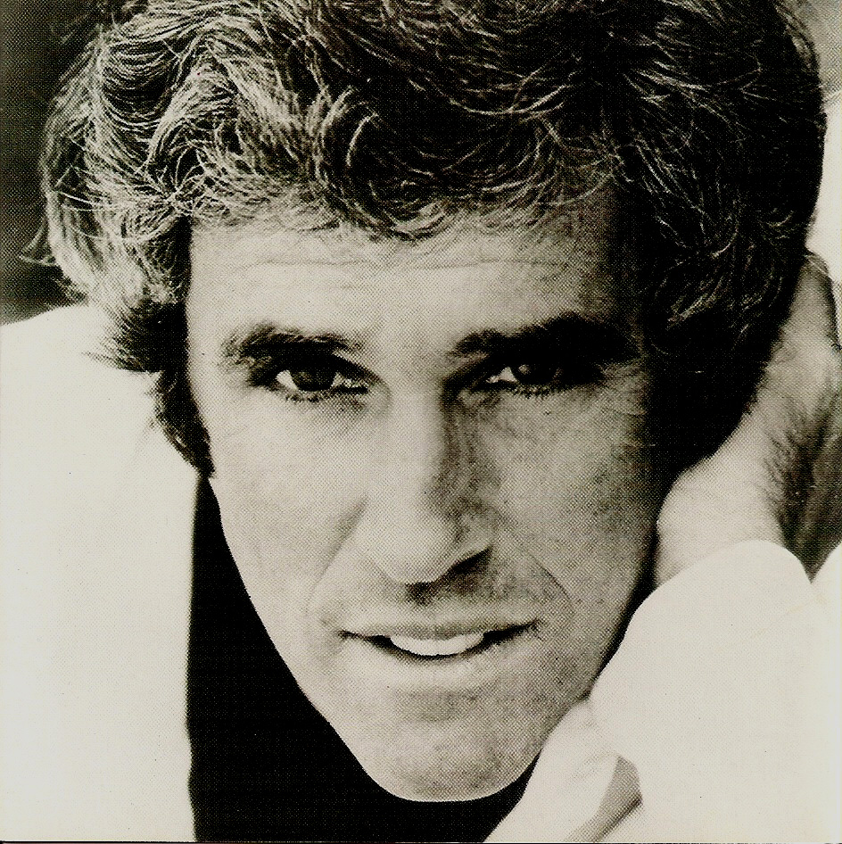
Notes:
I didn’t start out my DNA career looking for famous rabbis.
I was somewhat curious about this guy:
Anyone recognize him?
My husband's paternal grandmother's parents were both Bacharachs. I had come across the name—besides Burt, there was David Bachrach, the photographer who captured the crowd at the Gettysburg Address, and Harry Bachrach, the former mayor of Atlantic City who was immortalized as a character on Boardwalk Empire. I wondered if these different families might be related to each other and to my husband's family. So in 2009, I started the Bacharach DNA project and recruited men to test their Y-DNA.
What I found was a big surprise. Not only do 16 Bachrach men whose ancestors came from 10 different locations in Europe share a common Bacharach ancestor, but…

Slide 5
Abraham BACHRACH ca 1540
Abraham Samuel BACHARACH 1575
Arye Leyb BACHRACH ca 1680
Arye Leyb BACHRACH abt 1787
Arye Leyb BACHRACH 1864
David Hyman BACHRACH 1867
Israel BACHRACH
Jacob BACHARACH ca 1650
Jacob Ben Moses (Ba’al Ha-Ma’amari) BACH(A)RACH 1824
Jair Hayyim BACHARACH 1638
Menachem BACHARACH ca 1470
Mendel BACHRACH
Moses BACHARACH
Moses Ben Isaiah Menachem BACH(A)RACH 1574
Moses Samson (Simson) BACHARACH 1607
Naftali ben Jacob Elchanan BACH(A)RACH ca 1600
Naftali Herz BACH(A)RACH ? 1570
Shlomo BACHRACH
Shlomo BACHRACH ca 1630
Shlomo BACHRACH ca 1765
Shmuel BACHRACH 1650
Tuviah (Tobias) BACHRACH ca 1600
Ya’acov BACHRACH ca 1730
Ya'acov BACHRACH ca 1795
Yehuda BACHRACH 1775
Moses BACHARACH (WAAG) ca 1580
Wilhelm BACHER 1850
Schmuel BIKRACH-SCHWAB ca 1575
Ascher Alexander Susskind SCHWAB ca 1635
Joseph SCHWAB ca 1605
Sanwel Ben Ascher Bacharach SCHWAB ca 1665
Notes:
It turns out there are a lot of Bacharach rabbis, including a couple of famous ones: Rabbi Yair Chaim Bacharach, who was a great-great-grandson of the Maharal of Prague, and Rabbi Tuviah Bachrach, who was martyred in Rhuzany, Belarus in 1659.
We do have descendants of Rabbi Tuviah in the project, but I haven't yet located a male descendant with the Y chromosome of Rabbi Yair Chaim to test.

Slide 6
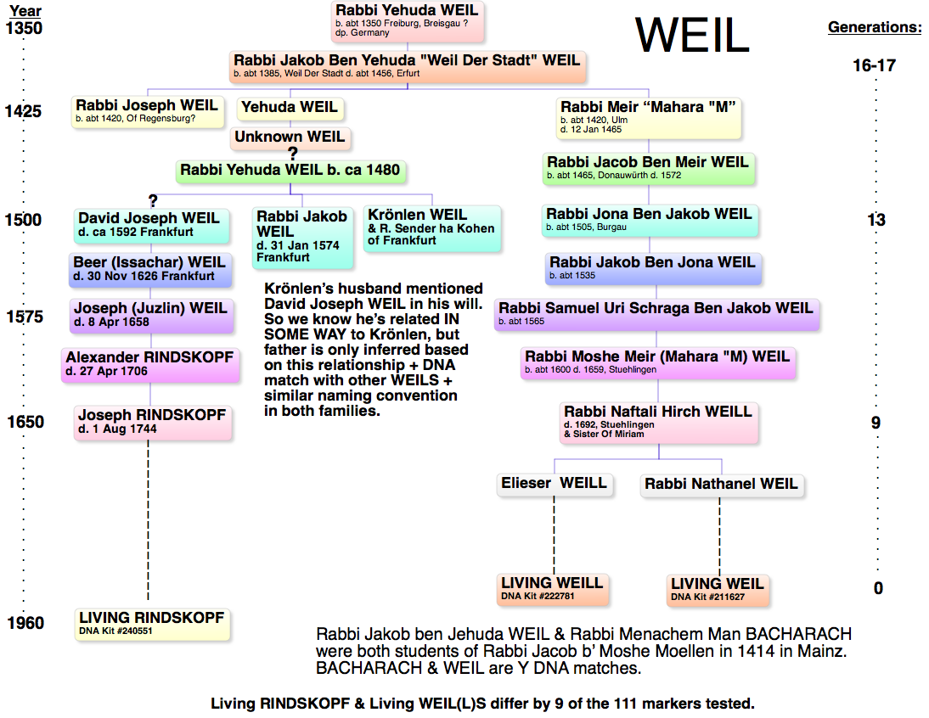
Notes:
Not only do Bacharachs from all over Europe match each other, but they also match a larger group called the WIRTH project. It's a lineage of more than 200 men, whose ancestors were mostly from Eastern Europe, and who share a common ancestor approximately 900 years ago. None of them likely expected to be descended from rabbis, because they don't have well-known surnames, but their DNA matches to varying degrees three rabbinic families: Weil, Bacharach, and Wertheimer. It’s likely that the common ancestor around the year 1100 was a rabbi, since at that time most rabbis became rabbis because their fathers were rabbis. They would not have known this without having tested their Y chromosomes.This chart shows the path of the possible Y-DNA of the Rabbi Weil der Stadt and how DNA can bridge across gaps in the paper trail, something Janet will be explaining later.

Slide 7
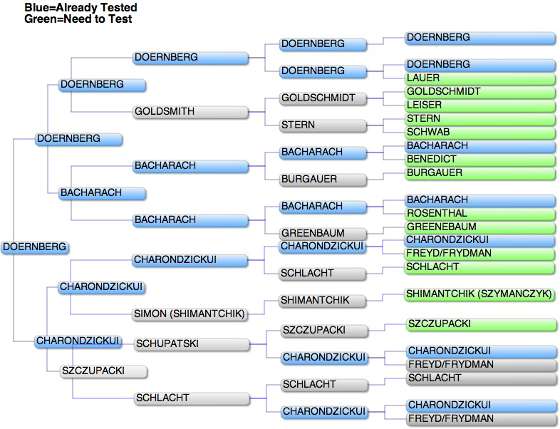
Notes:
How do you go about looking for Rabbis on your family tree? Go back as far as you can in your pedigree on all branches, looking for well-known surnames (for example those on the Jews of Frankfurt project website). If you see a likely surname, you can find candidates to test by looking for males in each generation who have living male descendants to represent that surname branch. Since the Y chromosome is passed only from father to son, you will need to locate a son of a son of a son of that surname ancestor. This might be a second, third or more distant cousin, but it doesn't matter. They can still be your proxy for that surname line. Try to find a proxy tester for each of your surnames. This is my husband's chart, showing which surnames I've tested and which I still need to convince someone to test. Notice this example of pedigree collapse, where he has the same couple as 4th great-grandparents three different times. The grey names are the duplicates.

Slide 8
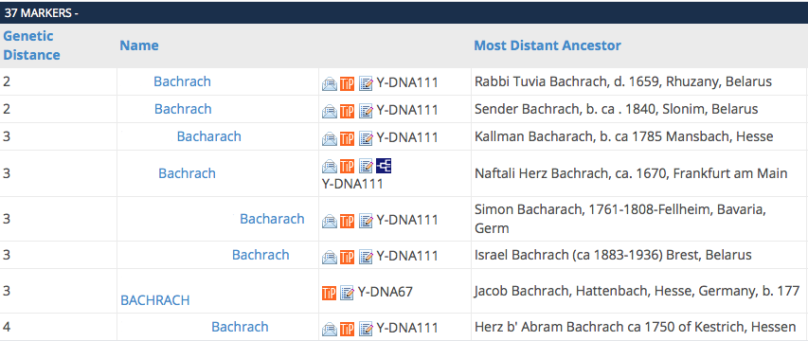
List of Y-DNA Matches (FTDNA)
Notes:
When you test at FTDNA, you get a match list similar to this (first names have been redacted for privacy). For simplicity, I’m showing you here only a few of my husband's third cousin's matches who are named Bacharach or Bachrach. Not all his matches have the Bacharach surname. Note the column to the far left, “Genetic Distance.” This is a measure of how different these men’s Y-chromosome are from each other. For example, the first one, a descendant of Rabbi Tuvia Bachrach, has a genetic distance of 2, meaning they match on 35 out of 37 markers, or locations on the chromosome. From that information we can click the orange square to compute the probabilities of how far back their shared ancestor lived. We know these men on the list all had a common ancestor, even though we don’t have a paper trail to connect them. The DNA says they all have some version, with a few changes or mutations, of that original Y-chromosome passed down from that one man, maybe their eighth or tenth great-grandfather, or maybe further back. In the case of the Bacharachs, I estimate their common ancestor to have lived in about the thirteenth or fourteenth century. How do they have the same surname when Jews did not get surnames until the eighteenth or nineteenth centuries? We’ll get to that shortly. The important thing to remember is that you have a common male ancestor with everyone on your match list.
At this time, Family Tree DNA (FTDNA) is the only company that does Y chromosome testing. The most basic test covers 37 markers. You can also order 67 or 111 markers, but usually you start with 37 and upgrade from there if appropriate.

Slide 9
What to Do with the Test Results
Look at your closest matches (genetic distance of 3 or less on a 37-marker test)
Recognize any surnames (other than your own)?
Any surnames on the Jews of Frankfurt list?
Any matches who are in the WIRTH project?
Any matches with a very old “Oldest Known Ancestor”?
FTDNA has many groups run by volunteer administrators
Join your haplogroup project
Contact administrators of surname projects of your matches to see if you can join
Contact administrators of other Jewish projects to see if you can join
Notes:
Once you've convinced your designated Y chromosome cousin to test, and his results are back, what next?
Besides your match list, which we saw on the last slide, you need to look at your haplogroup designation on the FTDNA website. It shows prominently on your home page there.
A haplogroup is the large branch of the human family tree your Y-DNA belongs to. Haplogroups are designated by letters and numbers. Most Jewish Y-chromosome results belong to G, I, J (1 & 2), Q, R, or T. For example, the Bacharachs are in a subgroup of J2 called J-556.
We won't get into this any more than to say you should seek out the appropriate haplogroup project and join it. The volunteer project administrators will advise you on further testing, and you'll be better able to see your results in context with others in your haplogroup.
Your results are meaningless in themselves—they only make sense when compared with others. Haplogroup projects, regional projects, and surname projects provide context, so reach out and join all appropriate projects.

Slide 10
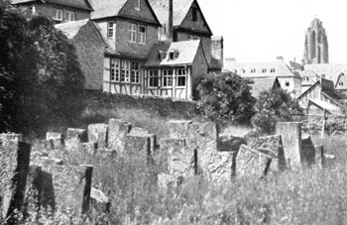
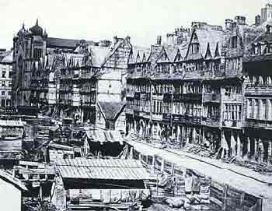
STABLE SURNAMES
STABLE POPULATION
/RELATIVE PEACE
TRADE ROUTE
Battonstrasse Cemetery
First interment 1272
What’s so special about Frankfurt?
RABBINIC CENTER &
PROXIMITY to
WORMS & MAINZ
ELE TOLDOT RECORDS
Notes:
I mentioned looking at the list for the Frankfurt project for possible matches.
What's so special about Frankfurt?
Frankfurt has been an important city and a crossroads for centuries
Many of the Frankfurt families have had surnames since the Middle Ages
Extremely old records are available in Ele Toldot, a Collection of transcriptions of genealogical records of the Jewish Community of Frankfurt from 1241 – early 19th century done by Shlomo Ettlinger. Search for it on the Leo Baeck Institute Website.

Slide 11
DOCUMENTED LINEAGES
REPRESENTED IN THE JEWS OF FRANKFURT DNA PROJECT:
BACH(A)RACH, BAMBERGER, WERTHEIM(ER),
WEIL, GOLDSCHMIDT, BRILLIN/BRÜLL, EPSTEIN, FULDA, GEISMAR, GÜNZBURG (ULMO), GUGGENHEIM, LORCH,
ESKELLES (Maharal of Prague line), RINDSKOPF, SCHNEERSON (Chabad line), OPPENHEIM(ER),
HALPERN/HEILBRONN(ER), SICHEL, TREVES,
LEVITE: BEYFUS/SCHEUER, ÖTTINGEN-REISS,
ROTHSCHILD, SPIRA/SPIER/SPEYER/SHAPIRA
Total Members: 110 (≈ 50% recruited)
Notes:
This list is also on our website.

Slide 12
SURNAME MISCONCEPTION #1
JEWS DIDN’T HAVE SURNAMES UNTIL
MANDATED IN THE LATE 18TH TO THE EARLY 19TH CENTURY.
Rabbinical: SPIRA, TREVES, LURIA, WEIL, BACHARACH
Houses: HAAS, SICHEL, ROTHSCHILD, SCHEUER
Occupations: GOLDSCHMIDT, HONIG, SCHAMES, KOCH
Town of Origin: BACHARACH, WERTHEIM, WORMS, MAINZ
Notes:
Getting back to surnames, there are some misconceptions about Jewish surnames. It's true that in most of Europe, governments mandated inherited surnames beginning in the late 18th century up into the late 19th century
There were exceptions. Some famous rabbinical families adopted surnames much earlier than the rest of European Jews (some examples are LURIA, WAHL/KATZENELLENBOGEN, and SPIRA) and in a few communities like Frankfurt, Jews of all walks of life used surnames early. Sometimes they were kept only for a generation or two and then changed, but especially in Frankfurt these surnames often persisted, up to the present.
Surnames in Frankfurt typically came from town of origin, name of house or occupation. , the great majority of European Ashkenazic Jews took their surnames during the period from the end of the 18th century to the middle of the 19th century.

Slide 13
SURNAME MISCONCEPTION #2
MY ANCESTORS SPELLED THEIR SURNAME DIFFERENTLY, SO THEY CAN’T BE THE
SAME AS ANOTHER FAMILY.
SHAPIRO, SHAPIRA, SPIRA, SPIRO,
SPEYER, SPIER, SPEIER, SPEAR
BACHARACH, BACHRACH, BACHER
WERTHEIMER, WERTHEIMBER
WERTHEIM, Von WERTHEIMSTEIN
Notes:
Spelling was not consistent across time or locale until fairly recently. Y DNA has proven that Bacharach and Bachrach without the middle “A” are the same name. Especially when you write a German name in Hebrew letters and then transliterate it back, variations can easily creep in.

Slide 14
SURNAME MISCONCEPTION #3
OUR FAMILY ACQUIRED THEIR
SURNAME RANDOMLY. WE HAVE
NO CONNECTION TO THAT OTHER
FAMOUS FAMILY OF THE SAME NAME.
Notes:
Merchant and rabbinic families were much more mobile than you might think. Branches of many Frankfurt and Worms families like the Bacharachs were also in southern Germany near Augsburg, Vienna, Prague, and farther east. Don't discount the possibility of it being the same family until you see who your DNA matches.

Slide 15
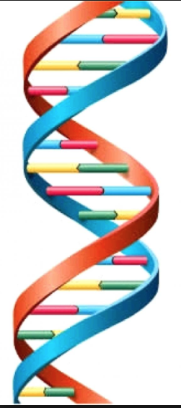
Shapiro Y DNA
Haplogroups:
E- 1, G-M377- 4, I- 1,
J1- (BY68) 2, J1-2 (other)
J2 (M560)-2, J2 (other) – 5,
L-1, Q – 1, T-3
R (L23) – 9, R (other) – 4
Notes:
15. Shapiro Y-DNA Haplogroups
I also am the administrator of the SHAPIRO DNA Project. This project would be the one to join if your surname is SPIER, SPIRA, SPEYER, SHAPIRO, or any of the many variant spellings. Keep in mind that spelling is only marginally important as all are variations of the same surname, as will soon become clear.
Unlike BACHARACH, my SHAPIRO are not all in the same haplogroup. I have men from at least 12 distinct haplogroups. You might think that just because they do not match each other they aren’t related. However, those in red all have men who have rabbinical matches to men with pedigrees as far back as the 15th C. So they all may be able to find a path to rabbinical line.
……………………………..
Haplogroup: A haplogroup is a major branch on either the maternal or paternal tree of humankind. Haplogroups are associated with early human migrations. Today these can associated with a geographic region or regions.

Slide 16
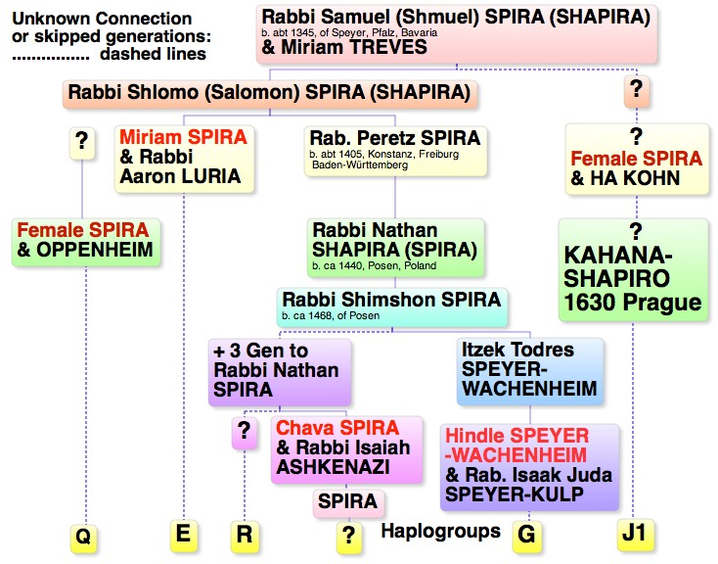
Notes:
16. Haplogroups off of the Spira Rabbinical Line 2:09
There are quite a few places in the genealogy of the rabbinical Spira family where females married into other rabbinical lines. However, perhaps because the Spira name was more prestigious, the family chose the surname of the female spouse. This was very common. Of course only one line will have the Y-DNA for the progenitor of the Spira line, but that doesn’t necessarily mean that if your name is a variation of Spira, that you aren’t related!
There are three places where known female offspring passed along the SPIRA surname to offspring. In the case of Hinda Speyer, I can guess that her male offspring will be “G” because KULP is a surname that comes off of the HEILBRONN family of Frankfurt, and we believe they are from haplogroup “G”. I don’t know if any offspring of Miriam took the Spira name, but if they did, they might be E which I’ve been told by Chaim Luria is their haplogroup. Hava Spira as well passed along her father’s name and this line is quite well documented so there should be males who can tell us to which haplogroup they belong.
I’ve also added a few other lines that COULD be related, but there are may more that I just couldn’t fit and don’t have the time to discuss. For example, we have a “Q” who is a close match to the OPPENHEIMERS. Their oldest known ancestor was born ca 1430. We also have a KAHANA-SHAPIRO who also are from a very prominent rabbinical line. They can trace their line back to Rabbi Moses Aaron K-S b. ca 1630. Their oral history also suggests much earlier roots and further research may reveal their connection.
Finally I have my “R” group which includes my 5th cousin Jeremy SPEAR. This is the group that I have identified as most likely to represent the Y-DNA of R. Samuel SPIRA of Speyer (b. ca 1345).
………….
NOTES:
We do know that the KAHANA SHAPIRA are J1. I’m not certain of their connection, but I have some reason t suspect that their connection will be to a Rabbi Akiva ha Kohen who was an exhile from Spain in Salonika, Greece in the 14th C.
G Terry McDonald/Meyer Shapiro b. ca 1845 Ukraine is match w/ Guggenheim
Ari Shapiro is a match man oldest known ancestor is Chaim Luria ca 1750, has oral history of descent from famous rabbis
J1 (KAHANA-SHAPIRA) 25% matches some variation of Kohen name, Allen Spira’s oldest known ancestor was Rabbi Moses Aaron K-S b. ca 1630. Oral history of K-S suggests that all Spira
ha Kohen are related. So it is possible that they are descendants of a Rabbi Asher Cohn-Spira b. ca 1400. Some on Geni have suggested he is a son of R. Samuel Spira, but that is
impossible because the Spiras were not Kohane. More research is necessary here, but I do believe that this branch is a female offshoot of the rabbinical Spira.
As for the DNA, their markers are quite similar to Rappaport, and I believe that our Kahana-Spira has some on his match list. However additional testing reveals that this connection is very far
back. There also is reason to suspect that the patriarch could be Rabbi Akiva ha Kohen of Salonika Greece (14th C exhile from Spain) (Burstein match) and I’m pursuing this theory based solely on what I’ve observed on the DNA match list of Allen Spira and research that show that the surname BURSTEIN was taken by one of the male offspring and the observance of a match with a man named BURSTEIN.
J2/Wirth -have 2 who match the rabbinical WIRTH. I couldn’t fit it them on the chart, but if you are a J2, you would look for Weil, Bacharach, or even Treves on your match list.
Q- Israel Shapiro b. 1866 Lithuania (12) matches Oppenheim of Hamburg > Jehuda O. b. ca 1430 of Worms
R-L23 SPIRA –more later

Slide 17
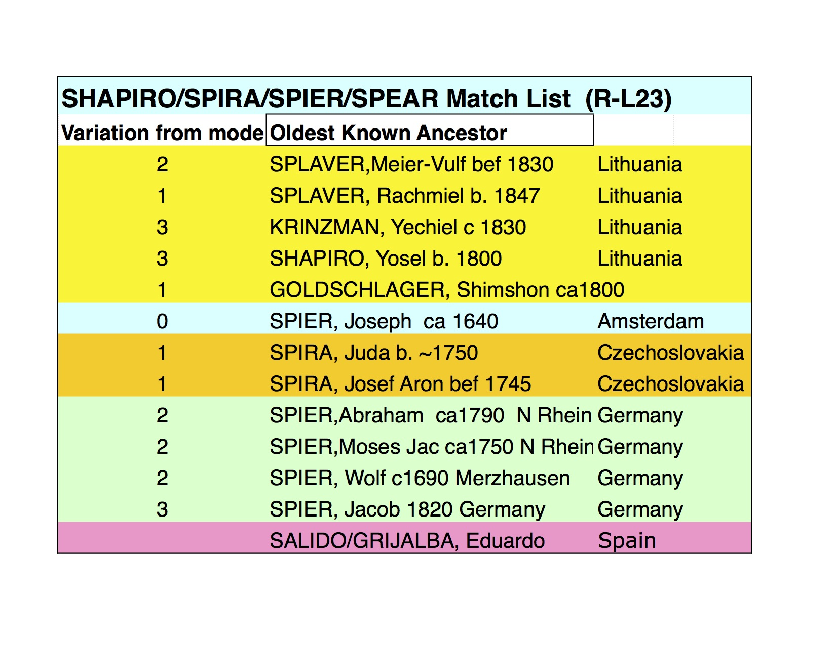
Notes:
17. SHAPIRO “R” Match List 1:45
This is a match list for my “R” haplogroup SPIRA. Like the rabbinical Bacharachs, many in this group bore some variation of the Spira surname hundreds of years before most Jews took surnames. For the most part only famous rabbinical families, or wealthy merchant families like Oppenheimer and Wertheimer had surnames this early. However, as Rachel pointed out, families in towns like Frankfurt also may have had surnames.
Also notice the Geographic Distribution of this surname, which supports the fact that they had a surname from a very early date. Notice that in this “R” group we have 5 from Lithuania, 1 from Amsterdam, 2 from Moravia, and 5 from Germany.
Each of the men represented on this chart did a 37 marker Y-DNA test. The number on the right shows how each differed from the overall mean for the group. Most of these men are all on each other’s match list. So they all share a common ancestor who lived no more than 24 generations ago …. and probably much later.
This is a very, very small haplogroup where almost ½ of the men have some variation of the Spira surname. I can’t tell you enough how rare it is to have a Jewish Y-DNA haplogroup that is also a surname group! It’s premature to tell you for certain that these men represent the rabbinical Spira line, but if not, they likely still must share a common ancestor from an important rabbinic lineage. Nonetheless you can also see that there are others like our GOLDSCHLAGER member who was quite surprised to find himself in this group. So just because your name isn’t associated with any known rabbinical lines, doesn’t mean that your line isn’t rabbinic!
For brevity’s sake, I will be referring to this group as my R group in the next few slides.

Slide 18
DNA Matches Bridging to Paper Trail
Documented Ancestor
b. 1300
Generation 1
b. ca 1330
Generation 14
b. 1670
Gen 15 A
b. 1700
Gen 15 A
b. 1700
Gen 15 B
b. 1702
Gen 15 B
b. 1702
Dead End
Dead End
Dead End
Gen 16 A
b. 1730
GGF b. 1880
Gen 16 A
b. 1730
Gen 16 B
b. 1732
Gen 16 B
b. 1732
GF b. 1880
GF b. 1910
Father b.1910
Father, b. 1940
Gen 24 A
b. 1970
Gen 24 A
b. 1970
Gen 24 B
b. 1972
Gen 24 B
b. 1972
Living b. 1950
Living b. 1970
DNA Match:
Estimated 8 generations to A
10 generations to B
DNA Match:
Estimated 10 Generations
to both
Notes:
About 1/2 of the members of the SHAPIRO DNA project have surnames that are some variation of the SHAPIRO name. Still there are another 50% who have neither the surname, paper trail or oral history. Many of them have brick walls only a few generations back. But they match SPIRA, some of whom have well documented family trees. So what does that mean?
If you look at that Genetic Distance number that Rachel pointed out, located on the left hand side of your match list, you can get a very approximate idea of when you share a common ancestor with your match.
So if you happen to be lucky enough to match someone who has an ancestor who was born around 1300 , then you and everyone else on your match list who appears to be related AFTER 1300 are likely to share that same common ancestor. Even if they can’t pinpoint the exact connection, they can estimate their relationship. We call this “bridging.” In the absence of a paper trail, it allows you to push back beyond your brick walls. There will always be a gap where you’re missing documentation, but you can connect to the oldest branches of your tree.

Slide 19
Notes:
This is a very finely pruned family tree for the rabbinical Spira. Offspring have been identified but not yet tested who are offspring of Schlomo Shapiro who was born around 1550 in Moravia/Czech. In order to validate this line further back, it would be necessary to identify offspring of other lines. However, if we can test one or more of the known offspring and get a match to one of the haplogroups in our Shapiro DNA Project, we will be able to validate the line back to Shlomo. If this match is to our large R1b1 group, that would also suggest that many other branches of this tree share the same Y-DNA.
It’s my suspicion that my SPIER from Amsterdam, Prague and North Rhein are more likely offspring of Rabbi Yechiel Michel Spira than Rabbi Nathan Spira. I have noticed some disagreement as to the father of Yechiel. Some believe that it was Rabbi Shimshon and others say it was Rabbi Joseph ben Kalonymous Jerushalmi.
As Rachel explained when she discussed “Bridging” we can only document a line as far back as the common direct line male ancestor of two men who have matching Y-DNA. However, if it were possible to connect any of the men in my project to Nathan’s brother Yechiel AND if their DNA were to match the DNA of documeted offspring of Rabbi Neta Nathen Spira, by virtue of “bridging”, that would allow us to ascertain the Y-DNA of Rabbi Shimshon Spira of the 15th Century.
As you can see SPIRA isn’t the only surname that connects to the SPIRA rabbinical line. There are other variant spellings like SHAPIRO, SPIRO, SPEYER, SPIER, SPEAR,& SPIRE. In addition, men with the surnames WEDELES, FRANKEL, HIRSCH, FRANKFURTER, GASSNER & HARDY may also have the same Y-DNA.
Note:
According to Muneles, Yerushalmi-Shapira's father was Kalman(Kalonymous) Spira. Some sources would indicate that he was Kalman Halberkasten, but it's far from clear. Source: Lawrence Weinberg

Slide 20
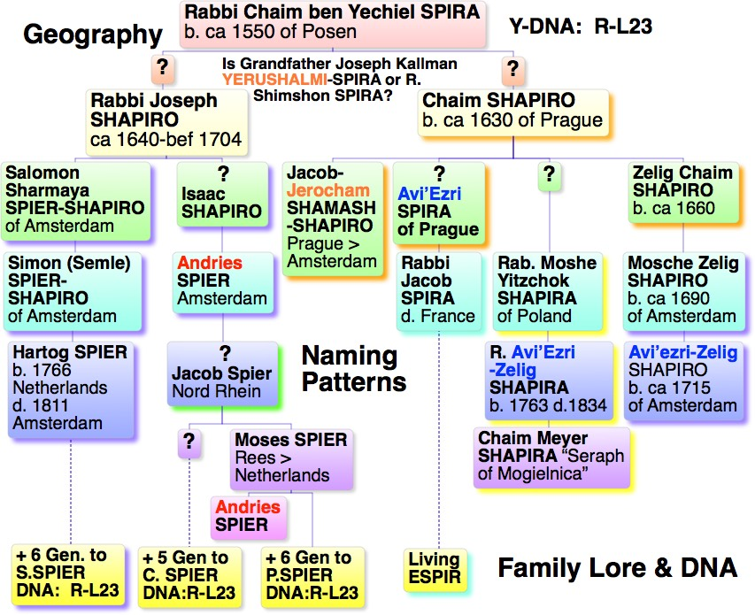
Notes:
20. Amsterdam Shapiro/Speyer- given names
On the far right side you can see lineages for 3 men who are in the R group. One is an offspring of a SPIER family who lived in Amsterdam in the mid 17th C, the others are from the Nord Rhein area, quite close to Amsterdam. Based on geography and the fact that the name Andries can be found in Amsterdam earlier than in the North Rhein, I believe that all three families have connections to Amsterdam.
Two sons of Chaim Shapiro of Prague came to Amsterdam Prague in the 17th C. One particular given name in this family is quite intriguing. The name Avi’Ezri appears in Speyer lineages in Amsterdam, Vienna, France and Prague. I also noticed that this family had the name Jerocham which may be associated with the Jerushalmi-Spira family. This family may link to Rabbi Jechiel Michael Spira. So perhaps I will be able to find that bridge to another brother through one of these men. Perhaps a “Living” ESPIR will provide the answer!
Oral history is always suspect. Still it usually contains a colonel of truth. In the case of these SPIRA, many relate that their family came from the town of Speyer OR that they are Sephardic. As it turns out, Rabbi Samuel Spira was born in Speyer around 1345. He lived in both Spain and France and married the daughter of Rabbi Mattithias Treves (also married to a Shapira).
Do all of these men fit together? I don’t know. But names provide valuable clues and the fact that all of these families were in the Amsterdam area is also interesting.
Additionally, we see that may of the SPIRA families in the “R” group have an oral history that they are from Spain and Speyer. Rabbi Samuel Spira was born ca 1345 and lived for a time in Spain, so their oral history as well as the fact that they have several matches with men from Spain can’t be ignored.

Slide 21
+ 5 Generations
Notes:
I began with my family and now I’m ending with my family. When I began researching my family 20 years ago, I didn’t know I had a WERTHEIM line, much less that they were from Wehrda a town about 13 miles north of Fulda. Now after years of traditional research, there is little I can expect to learn beyond what is available. I have many clues and speculations, but how to prove them?
I may never be able to figure out a connection to the WERTHEIM who lived in Frankfurt in 1500 or to Rabbi Samson Wertheimer. However, a very realizable goal would be to determine if I am related to Sir Nicholas Winton. I’m sure many of you heard of his death last Friday at the age of 106. He was knighted by Q. Eliza in 2003 for smuggling 669 children out of Czech during WWII.
My next step will be to get Y-DNA from his line because he descends from a rabbinical family who had the WERTHEIM surname as early as 1600. His family lived in the town of Eschwege, only 13 miles north of my family. If his Y-DNA matches the Y-DNA of my 5th cousin, that would take my own personal research back 3 more generations, and would connect me to a new 9X Great Grandfather and 7th cousin twice removed. His family moved to Eschwege after the 1671 expulsion of all Jews from Fulda. The Fulda expulsion list included the names Schmuel, Meyer and Naphtali WERTHEIM!

Slide 22
HOME*FAMILY CHART*DNA*MAPS*PHOTO GALLERY*GET INVOLVED*ABOUT US*CONTACT
The Jews of Frankfurt DNA Project
http://jewsoffrankfurt.com
Janet Billstein Akaha akaha@comcast.net
Rachel Unkefer ru@bacharachdna.com
http://bacharachdna.com
https://www.familytreedna.com/public/Jews_of_Frankfurt?iframe=yresults
Notes:
22. Conclusion
If you’re interested in joining our Jews of Frankfurt Project, you need to check out our website first. We are primarily looking for men with deep pedigrees along their “Y” line to the 17th century , some kind of connection to the Frankfurt/Worms/Mainz area, and one of the names on our list or a famous rabbinical line. So if you have doubts, please contact us first. We can’t add anyone based solely on a match with one of our members, or same surname from Eastern Europe.
If you are a candidate for our project, we may even be able to help you with your family trees. I even have prepared pedigree charts for many of our members that provide a huge amount of information that they do not have. I have added most of the Ele Toldot record from Frankfurt into my database and have almost 140,000 records.

Slide 23
Y-DNA WISH LIST
ADLER, BALLIN, BRANDEIS, DEUTZ, SPEYER-ELISSEN, EMDEN, EPPSTEIN, FALCKE, FLASHE, FRANKEL, FRANKFURTER, GANS, GINZ, GRÜNHUT, HAHN, HILDESHEIM, HEIMERDINGEN, HIRSCH, KAISER, KANN, HOROVICE/HOROWITZ, ISSERLES, KATZENELLENBOGEN, KULP, LANDAU, LINZ, LOANZ, LORIE/LURIA, MAAS, MAINZ, MEISE, NASSAU, OCHS, RAPP(EN), REIS(S), SCHLOSS, SCHUH, SCHNAPPER
SCHUSTER, SCHWARZSCHILD, SICHEL, SPANIER, STIEFEL, WAHL, WOHL, WARBURG, WETZLAR, WIMPHEN, WINDMUHLE, WINIG, WORMS(ER), ZINZ/ZUNZ
MOST DESIRED Y-DNA
BALLIN, BUCHBAUM, BAUER, FRANKEL, GOLDSCHMIDT,
HAAS, HAHN, KAISER, KULP, ROTHSCHILD, SICHEL, SPEYER, TRENEL, TREVES
Notes:
Names in red are all Y-DNA offspring of the ROTHSCHILD line, so the Y-DNA should be very close.

